Slide 1
Agile
2021

Slide 2
Introduction

Slide 3
What is Agile?
Agile is an iterative software development methodology to delivery software frequently with faster feedback cycles and with the ability to create and respond to change swiftly
Agile is based on the values and principles expressed in the Agile Manifesto and the 12 principles behind it.
Agile is..
Simple (not easy to apply)
Doing important things first – It respects urgency
About People, Values, Principles & Practices
Focused on Team Communication
Regularly delivering value through working software

Slide 4

What is Agile?
A framework for iterative and incremental delivery of a product or project
AGILE IS…
Simple (not easy to apply)
Completing important tasks first to respect urgency
About People, Values, Principles & Practices
Focused on team communication
Regularly delivers value through working software

Slide 5
Agile Manifesto
# | Principles
1 | The highest priority is to satisfy the customer through early and continuous delivery of valuable software.
2 | Welcome changing requirements, even late in development. Harness change to develop the competitive advantage.
3 | Deliver working software frequently, from a couple of weeks to a couple of months.
4 | Business people and developers must work together daily throughout the project.
5 | Build projects around motivated individuals. Give them the environment and support they need, and trust them to get the job done.
6 | Development teams communicate frequently. The most efficient and effective method of conveying information to and within a development team is face-to-face conversation.
7 | Working software is the primary measure of progress.
8 | Promote sustainable development. The sponsors, developers, and users should be able to maintain a steady pace indefinitely.
9 | Continuous attention to technical excellence and good design enhances agility.
10 | Simplicity -- the art of maximizing the amount of work not done -- is essential.
11 | The best architectures, requirements, and designs emerge from self-organizing teams.
12 | At regular intervals, the team reflects on how to become more effective, then tunes and adjusts its behavior accordingly.
Themes
Individuals and interactions over processes and tools
Working software over comprehensive documentation
Customer collaboration over contract negotiation
Responding to change over following a plan
That is, while there is value in the items on the right, we value the items on the left more
Quoted from the Manifesto for Agile Software Development, http://agilemanifesto.org
Notes:
Let me introduce you to the Agile Manifesto…today when a project declares that it’s “agile” or “agile-like”, typically this is the definition that projects are referencing. This is a document created by a set of software visionaries in the winter of 2001 just outside of Salt Lake City. They didn’t get together to create it; they gathered there to discuss lightweight software development processes. They backed off that goal to discuss what they could agree upon in regards to “flexible”, “simple” software development approaches. This is what they created. People today liken it’s significance in software development to the significance given to the US declaration of independence in regards to freedom and self-determination. It has and continues to challenge old notions and provide the team’s a voice in what they can deliver.
Let’s talk about this for a bit. On the left there, you see the four themes, and on the right, the 12 principles. Walking through the four themes…first, it’s all about people getting together, collaborating, delivering working software, in a manner that makes sense. Plenty of agile projects have succeeded in delivering valuable working software to the customer without tools, producing only the documentation that they feel they need to create, and revising any plans whenever they need to.
Now look at the 12 principles. I’m only going to bring your attention to three of them: first, number one: the highest priority is to satisfy the customer through early and continuous delivery of valuable software. Remember that this was created by a committee. They argued over every single word. Read that again. At FPL, who’s the customer? The business. How do we satisfy the customer? With frequent delivery of working software that they find valuable. Next let’s look at number four: business people and technical teams need to work together every day. MIT did a study recently that found that the more time the business person spends with the technical team, the faster the rate that technical team will deliver the functionality that the business finds valuable. So, the next time the business person asks when some functionality will be delivered, they need to be asked, how much time do you have to spend with the technical team? Finally let’s look at number 7: working software is the primary measure of progress. It doesn’t say that it’s the only measure of progress, but it is the primary one. We manifest this principle by performing frequent demonstrations to the customer.

Slide 6
12 Principles of “Agile Manifesto”
Our highest priority is to satisfy the customer through early and continuous delivery of valuable software.
Welcome changing requirements, even late in development. Agile processes harness change for the customer's competitive advantage.
Deliver working software frequently, from a couple of weeks to a couple of months, with a preference to the shorter timescale.
Business people and developers must work together daily throughout the project.
Build projects around motivated individuals. Give them the environment and support they need, and trust them to get the job done.
The most efficient and effective method of conveying information to and within a development team is face-to-face conversation.
Working software is the primary measure of progress.
Agile processes promote sustainable development. The sponsors, developers, and users should be able to maintain a constant pace indefinitely.
Continuous attention to technical excellence and good design enhances agility.
Simplicity--the art of maximizing the amount of work not done--is essential.
The best architectures, requirements, and designs emerge from self-organizing teams.
At regular intervals, the team reflects on how to become more effective, then tunes and adjusts its behavior accordingly.
Notes:
Ask them to pick one w the annotation tools to discuss further

Slide 7
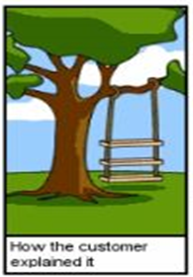
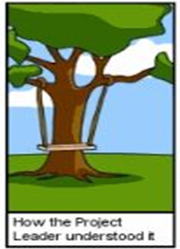
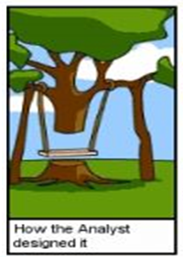
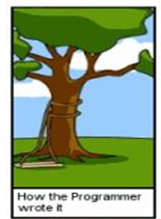

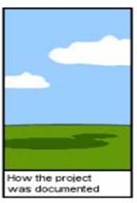
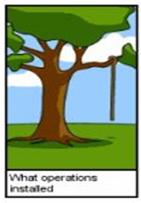
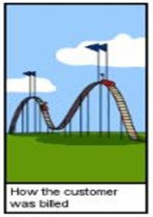
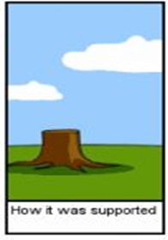
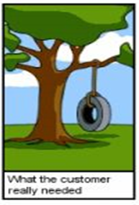
Traditional Lifecycle
Notes:
3 minutes - Discuss what are the risks in waterfall model and how will Agile fix these issues ?
- let the participants come up with ideas

Slide 8
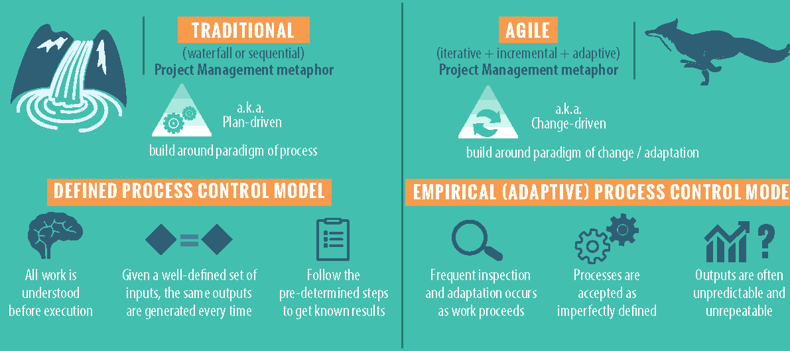
Traditional Vs Agile Approach
Notes:
1. Give examples on Empirical
2. Brief on the importance of empiricism
Reference: https://www.youtube.com/watch?v=spk0wTsi_P8

Slide 9
Task 1: Waterfall vs Agile

Slide 10
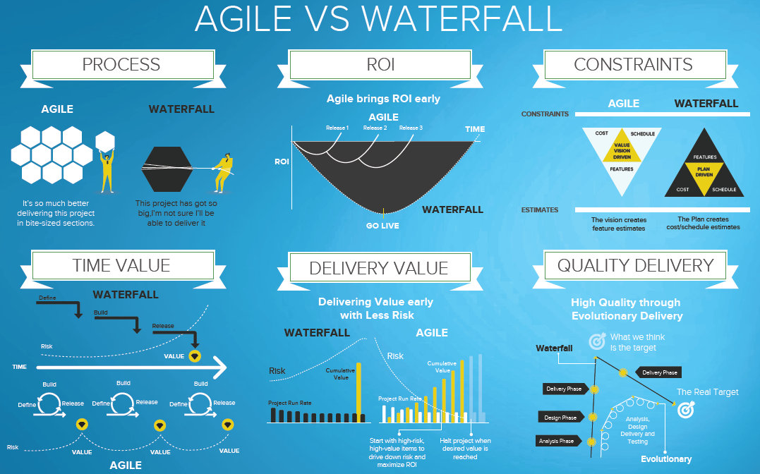
Agile vs. Waterfall

